Slide 1
ATS1208 Digital Humanities: Concepts, tools and debates
Week 3: What are ‘the humanities’?

Slide 2
Today’s lectorial
Humanities as a particular approach to education
The relationship between ‘the sciences’ and ‘the humanities’
The technologies and tools of ‘the humanities’
What are ‘the humanities’ heading today?

Slide 3
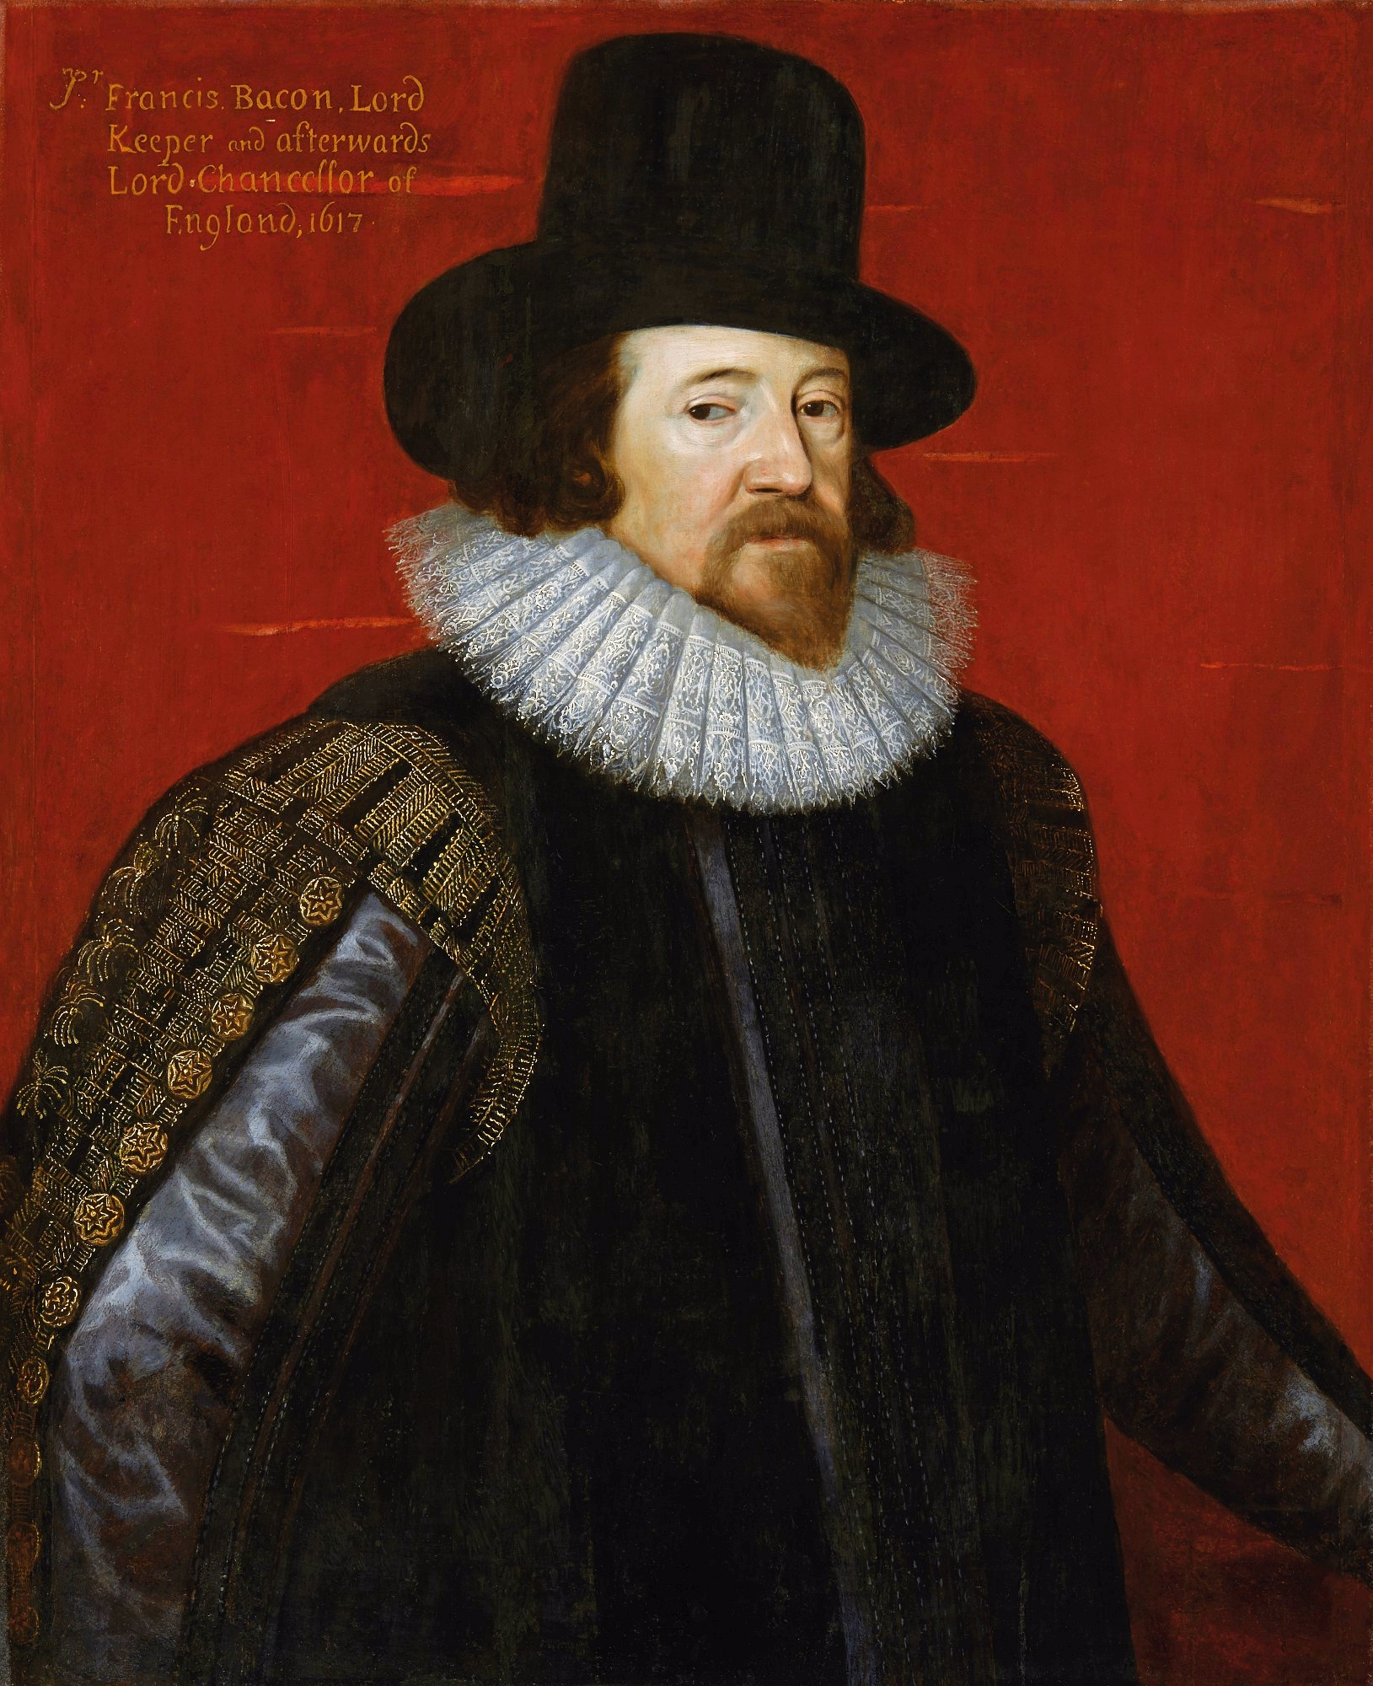
‘Before the Humanities, the Humanists’
‘In philosophy the contemplations of man do either penetrate unto God, or are circumferred to nature, or are reverted upon himself. Out of which there do arise three knowledges – divine philosophy, natural philosophy and human philosophy or humanity’
(Bacon 1605)
Notes:
The slide title stolen from David Rundle, which I will acknowledge when discussing this
http://interpretingplace.blogspot.com.au/2014/09/before-humanities-humanists.html
Main point – both natural philosophy (science) and ‘humanity’ came to challenge an established world view where divine philosophy lay at the centre of meaning
SM: Link to older concept of ‘humanism/humanist’? Maybe over-complicates, but idea that first move is to allow non-deistic perspective, split between science and other sorts of knowledge is later - is relevant I think
SM: exercise: how many disciplines can you name that you think of as part of humanities? Compare with person next to you, think about differences in classification

Slide 4
The origins of modern science
‘Galileian science … could have taken over the scholastic saying ‘individuum est ineffabile’ (‘we can say nothing about the individual’). Using mathematics and the experimental method involved the need to measure and to repeat phenomena, whereas an individualising approach made the latter impossible and allowed the former only in part’
(Ginzburg 1980: 15)
Notes:
The importance of Galileo – not only in terms of method, but also in advancing a perspective in which science questioned existing ways of seeing (the ‘Copernican revolution’ in astronomy)
Before Galileo’s time, science meant knowledge – only later did it acquire the meaning it has today, of being bound up largely with ‘natural science’
Here - in part – we can see the beginnings of the separation between science and ‘the humanities’

Slide 5
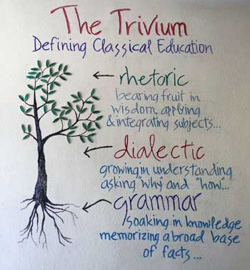
Education to promote Allgemeine Bildung
‘Traditionally, and especially during the last 200 or 300 years at least in the West (and since about that time in Japan, as well) an educated person was someone who shared a common stock of formal knowledge – someone who had what the Germans called Allgemeine Bildung and the English (and following them, the nineteenth-century Americans) called a Liberal education’
(Drucker 2012: 205)
Notes:
Is this what an Arts degree entails today?
SM: Idea that knowing a way of thinking about the world is a) basic skill and b) transferrable across content areas

Slide 6
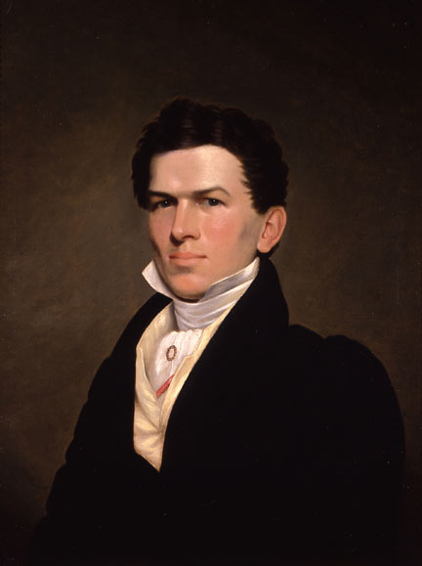
Education as personal development
‘the main concern of educators was to help pupils to integrate the different disciplines and knowledges they had learned into an unitary “mind set”, in an unitary self-sustaining complexity’
(Bologna 2004: 4)
Notes:
Talk to a neighbour about the following two questions:
Why would *this* kind of education be considered crucial in much of European and American society between the mid 1800s to the mid 1900s?
For which members of society was it intended? Why?
(male members of elites for most of that time, but opened up to a wider circle towards the end)
Is this what an Arts degree entails today?
SM: Idea that knowing a way of thinking about the world is a) basic skill and b) transferrable across content areas

Slide 7
What did a university look like in 1850?
In Copenhagen, the following faculties could be found:
Jurisprudence & Political Science
Mathematics & Science
Medical Science
Philosophy
Notes:
An important point here is that a range of mergers – and more commonly, splits – led to this arrangement, as specific fields distinguished themselves within ‘human philosophy’:
“1842-1850: The faculties are restructured: The University Faculty of Medicine and the Academy of Surgeons merge to form the Faculty of Medical Science (1842); the Faculty of Law is reorganised and becomes the Faculty of Jurisprudence and Political Science (1848); the Faculty of Mathematics and Science is separated from the Faculty of Philosophy (1850).
1877: The first female student is enrolled at the University. 1960-1980: Explosive growth. Student numbers rise from about 6,000 to about 26,000 with a correspondingly huge growth in the number of employees. Large new university buildings include the new Zoological Museum, the H.C. “
Are these ALL the faculties at that time?
http://www.nbi.dk/~petersen/OldPages/KU/ku.html

Slide 8
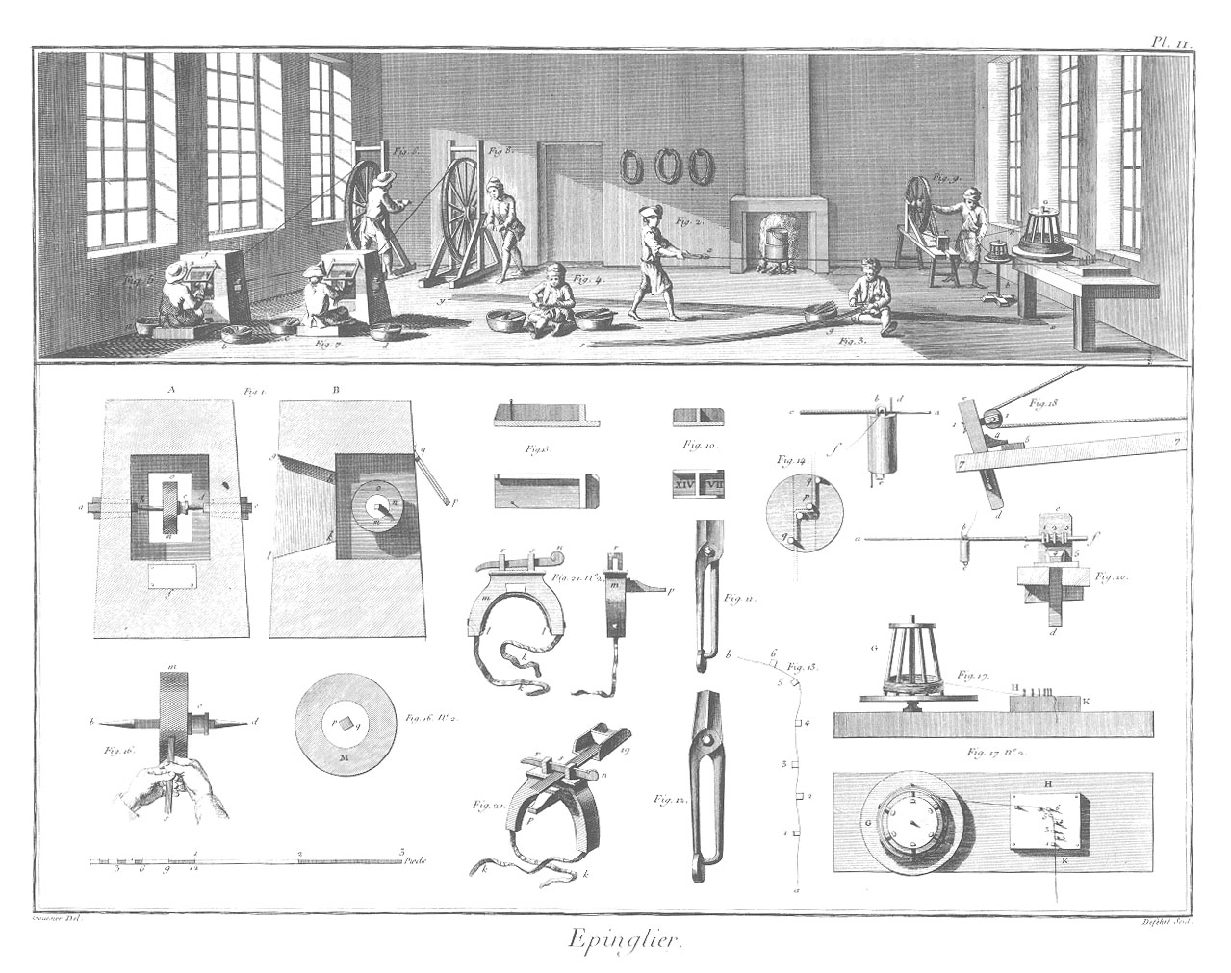
The rise of ‘disciplines’
‘Many improvements have been made by the ingenuity of the makers of the machines … some by that of those who are called philosophers or men of speculation, whose trade it is, not to do any thing, but to observe every thing; and who, upon that account, are often capable of combining together the powers of the most distant and dissimilar objects. In the progress of society, philosophy or speculation becomes, like every other employment, the principal or sole trade and occupation of a particular class of citizens. Like every other employment too, it is subdivided into a great number of different branches, each of which affords occupation to a peculiar tribe or class of philosophers; and this subdivision of employment in philosophy, as well as in every other business, improves dexterity, and saves time’
(Smith 2007: 12)
Notes:
McNeely Wolverton – a lot of shake out in the 19th century, as economics mutates out of ‘political economy’ etc

Slide 9
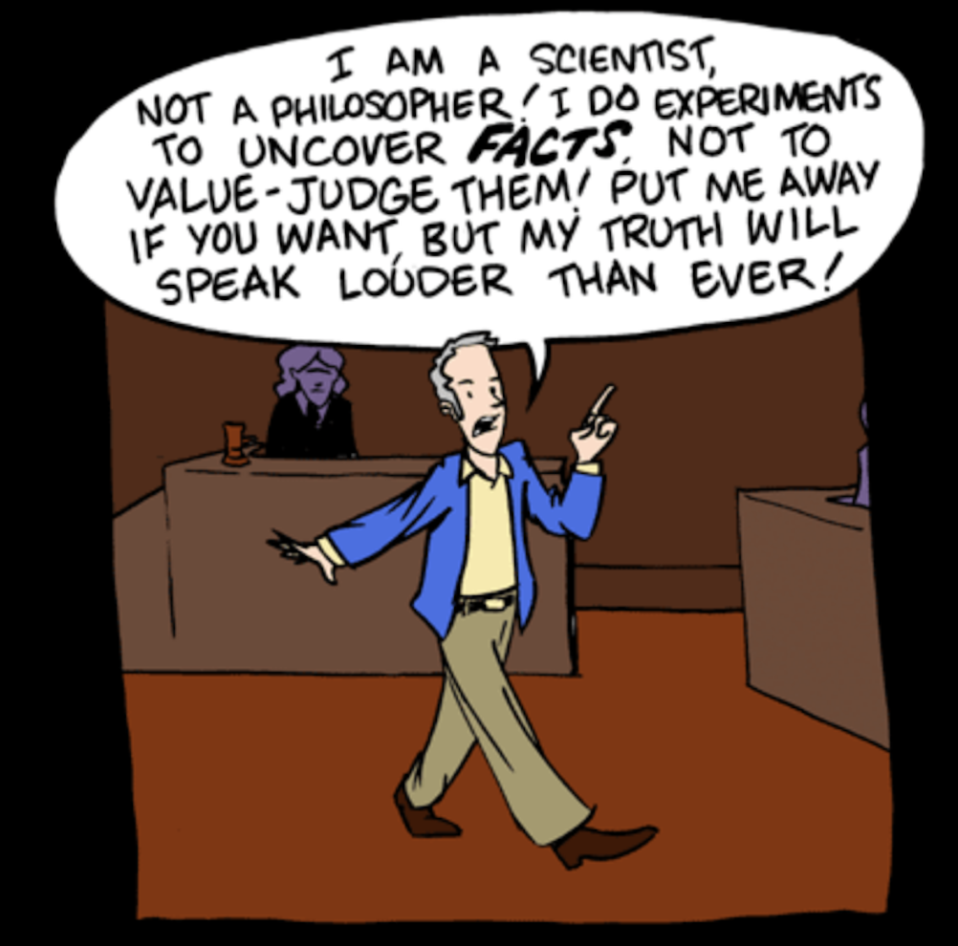
‘The humanities’ acquire a name
‘The relevant branches of learning were not collectively referred to as “the humanities” before the early twentieth century … it is important to recognize that the category of “the humanities” principally (though not exclusively) evolved as part of a defensive movement against the perceived challenge of a kind of positivism that claimed to be generalizing the methods of the natural sciences’
Notes:
The evolution of ‘the humanities’ within Western culture (but only Western?)
Their link to universities by the 19th and 20th centuries SM – might be interesting to sketch what a university looked like c1820? (theology, classics, medicine maybe….)
Are ‘the humanities’ the same as ‘Arts’?

Slide 10
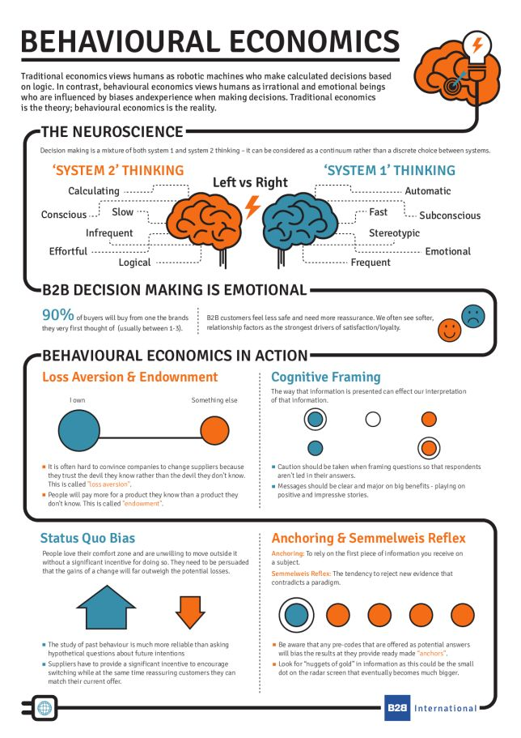
‘the humanities’ versus ‘the sciences’?
‘This impulse, strongly evident in the United States in the 1930s and 1940s, also meant that strenuous attempts were made to distinguish the humanities disciplines from those classified as “social sciences”, precisely because the latter seemed so much more hospitable to, or at ease with, the supposed methods of the natural sciences’
(Collini 2015: 273)
Notes:
The evolution of ‘the humanities’ within Western culture (but only Western?)
Their link to universities by the 19th and 20th centuries SM – might be interesting to sketch what a university looked like c1820? (theology, classics, medicine maybe….)
Are ‘the humanities’ the same as ‘Arts’?

Slide 11
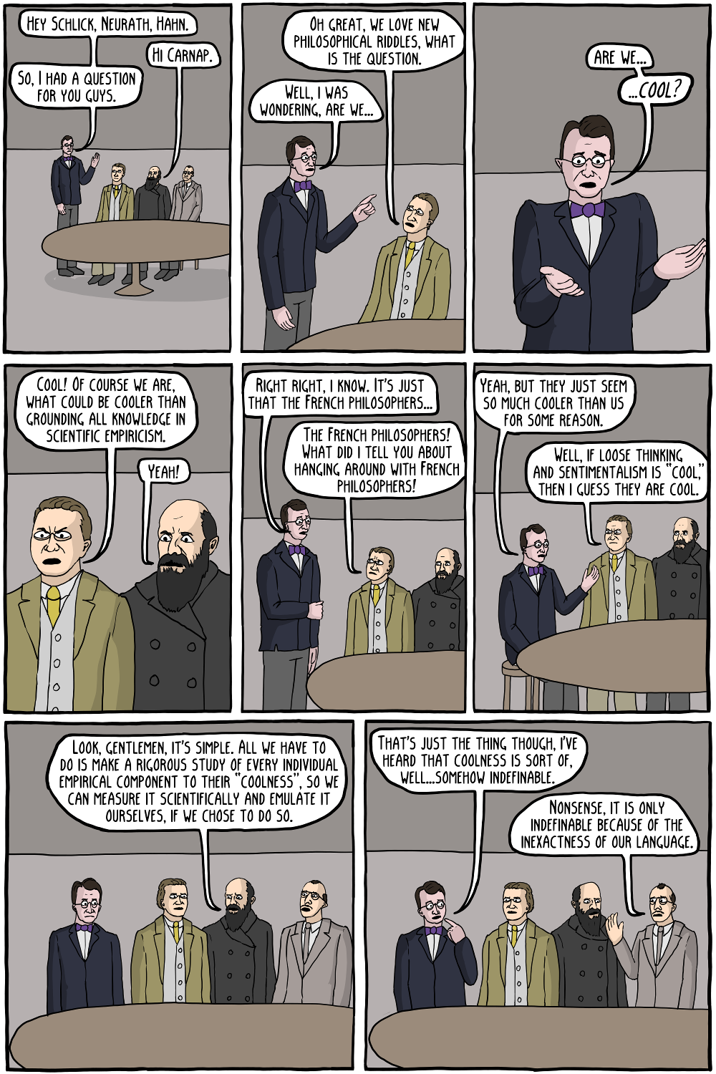
Positivism
‘the reduction of science to statements about directly observable facts and the elimination as meaningless of any sentence that is neither analytic nor empirical, e.g. of metaphysics’
‘the view that the social sciences and even humanities have basically the same aims and methods as the natural sciences’
(Giedymin 1975: 276)

Slide 12
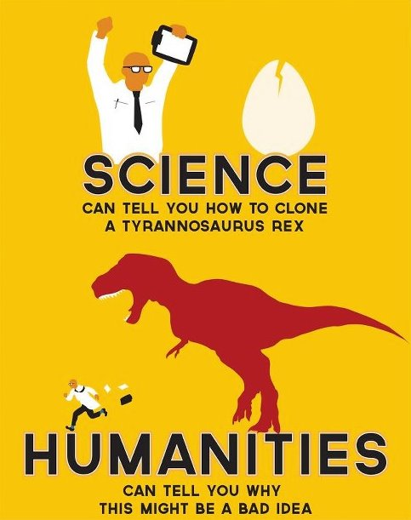
Humanities = ‘everything that isn’t science’?
‘while the humanities thrive on dispute and dialectic, science privileges academic consensus’
[Yet] … At the dawn of the 1800s, natural science and the humanities coexisted in remarkable harmony’
(McNeely & Wolverton 2008: 210)
Notes:
SM: simplistically, scientific/positivistic strategy is to plan in advance what will provide high-quality evidence and then use it uncritically, humanists view evidence more eclectically (opportunistically?) and core skill is weighing pieces of evidence against each other
SM: exercise: what could be evidence in relation to a question from these different points of view? (date of Australia Day might be a topical one?)
How did Melvil Dewey delineate ‘the humanities’ within his classification system?

Slide 13
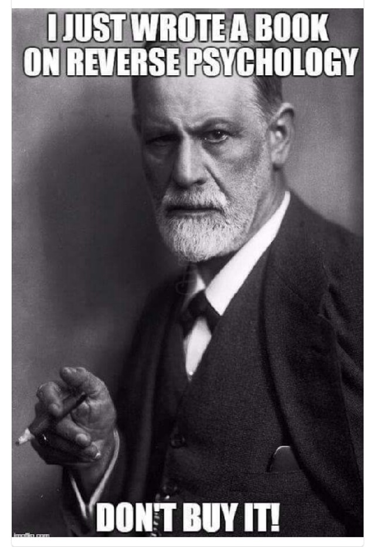
So where do we fit ‘the social sciences’?
‘In essence, humanities and the social sciences are the study of the human condition – a field of study concerned with human behaviours, exploring the contours of culture and society across space and time. The study provides a perceptive framework of the processes of social systems and examines the impacts of social organisation on the individual and groups.
‘Central to our approach is to develop the way students think and to offer a diversity of enquiry through a broad range of disciplines. We expect our students to become skilled in the use of language, and in the analysis of evidence, in whatever context it may present itself’
(Federation University Australia 2017)
Notes:
Look
Look over the list of disciplines in handout and identify which belong to:
Humanities
Social sciences
Natural sciences

Slide 14
Is it so easy to separate ‘humanities’ & sciences?
‘The proper rigour of the natural sciences could never be achieved by medicine, because of its inability to quantify (except in some purely auxiliary aspects); the inability to quantify stemmed from the impossibility of eliminating the qualitative, the individual; and the impossibility of eliminating the individual resulted from the fact that the human eye is more sensitive to even slight differences between human beings than it is to differences between rocks or leaves’
(Ginzburg 1980: 21)
Notes:
The boundaries are often less than clear
And not just because of the claims of the ‘social sciences’
As we’ve seen, some of the disciplines within the humanities have changed over time
And the sciences themselves have not been immune to processes of change
e.g. the rise of quantum mechanics
More than 50 years ago, in exploring the proposition that history could be a science,
the historian E.H. Carr wrote that
‘modern physicists constantly tell us that what they investigate is not facts, but events’ (What is History, p. 57)

Slide 15
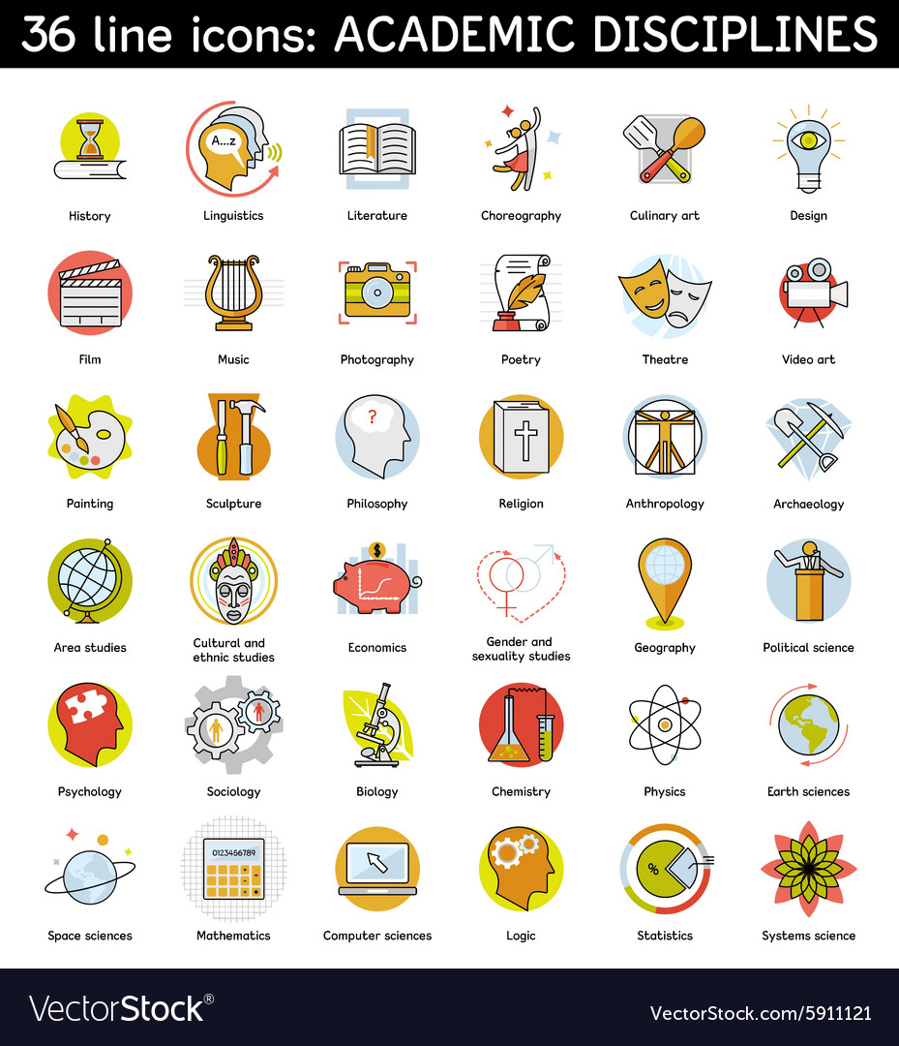
The re-definition of humanities ‘disciplines’
A number of the disciplines associated with humanities have shifted or been redefined over the past century
In many universities, sociology only established its own space after WWII, while other changes have accelerated within the last 50 years
For example, feminism has had an enormous impact across the humanities, from history to literary criticism
Notes:
the use of ‘oral sources’ has also had a significant impact upon history as a field of inquiry
SM: Sociology as a great example of relocation. For Weber, ‘meaning’ was central to sociology, but moving to social science changed that for later sociologists
and yet some sense of what constitutes ‘the humanities’ remains

Slide 16
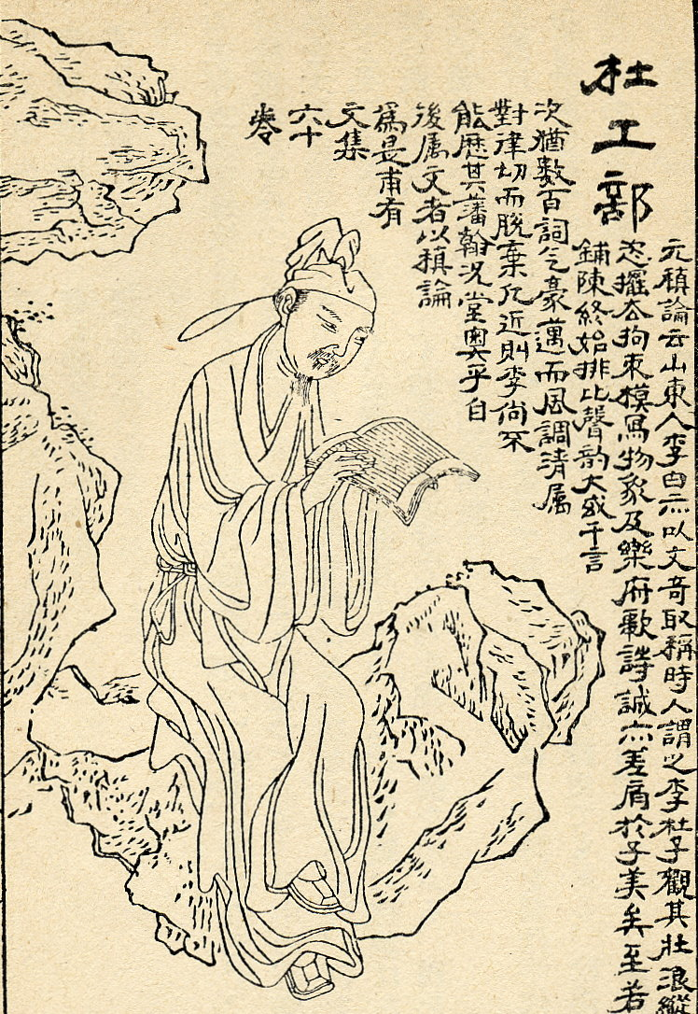
What ‘materials’ do historians handle?
‘Whether it is the bones immured in the Syrian fortifications, a word whose form or use reveals a custom, a narrative written by a witness of some scene, ancient or modern, what do we really mean by document, if it is not a “track”, as it were – the mark, perceptible to the senses, which some phenomenon, in itself inaccessible, has left behind?’
(Bloch 1984: 55)
Notes:
If some scientists have chemicals they can study in the laboratory, what types of materials do different kinds of humanities scholars (such as historians) ‘work with’?
As we will see, ICT offers the opportunity to work with documents in new kinds of ways
Are the humanities different from other ways of pursuing knowledge in this regard?

Slide 17
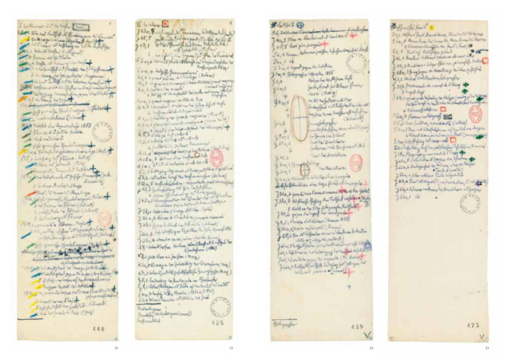
The humanities already have technologies
‘Traditionally, humanities scholars have used narrative to construct the portrait that furthers this objective. Narrative encourages the interweaving of evidentiary threads and permits the scholar to qualify, highlight, or subdue any thread or set of them—to use emphasis, nuance, and other literary devices to achieve the complex construction of past worlds’
Notes:
Royal Arcade
Some of Benjamin’s notes from the Arcades Project

Slide 18
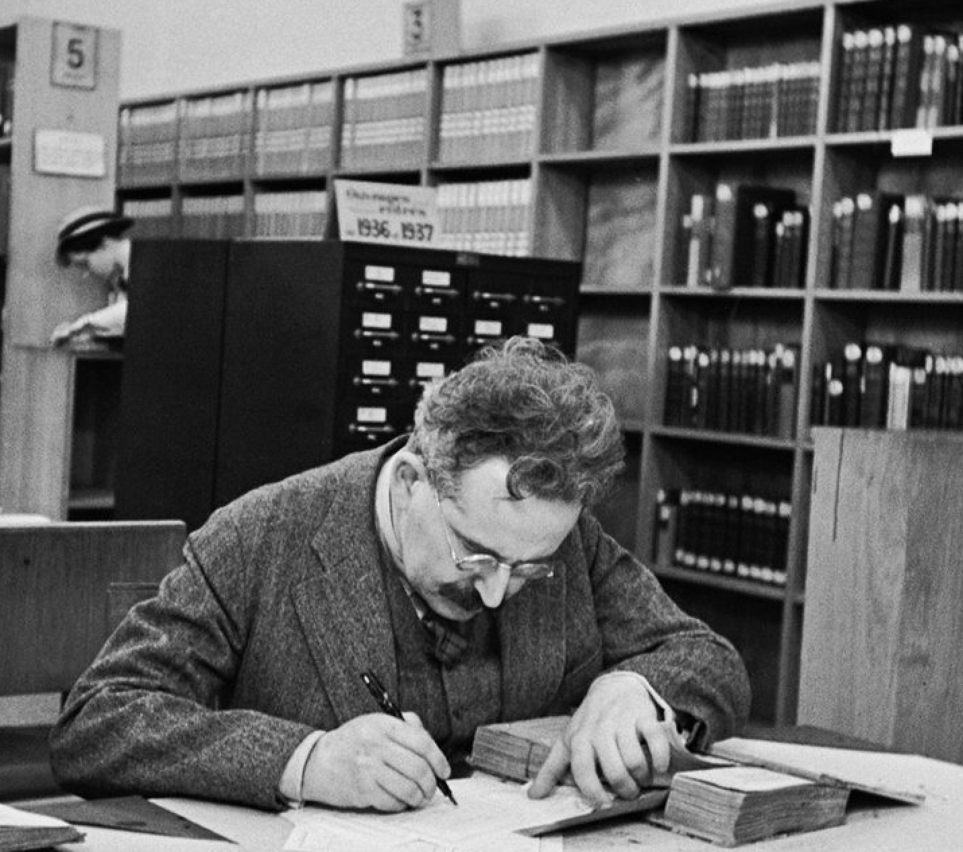
The humanities already have technologies
‘All of these elements—interdependency, narrative, and nuance, among others—predispose the humanists to look askance at any method or tool that appears to reduce complex events to simple schemes’
(Bodenhamer et al. 2010: xiii)
Notes:
Walter Benjamin had important things to say 80 years ago about the impact of new technologies – above all, photography and film-making – on the practice and consumption of art.
(an accompanying picture of Benjamin writing, and his notebooks)
Here I am eliding technologies/tools as physical extensions of the person (pen, paper, microscope, computer)
with conceptual tools (interdependency/narrative/nuance – and indeed rhetoric/dialectic/grammar)
And such an elision may not be a good thing

Slide 19
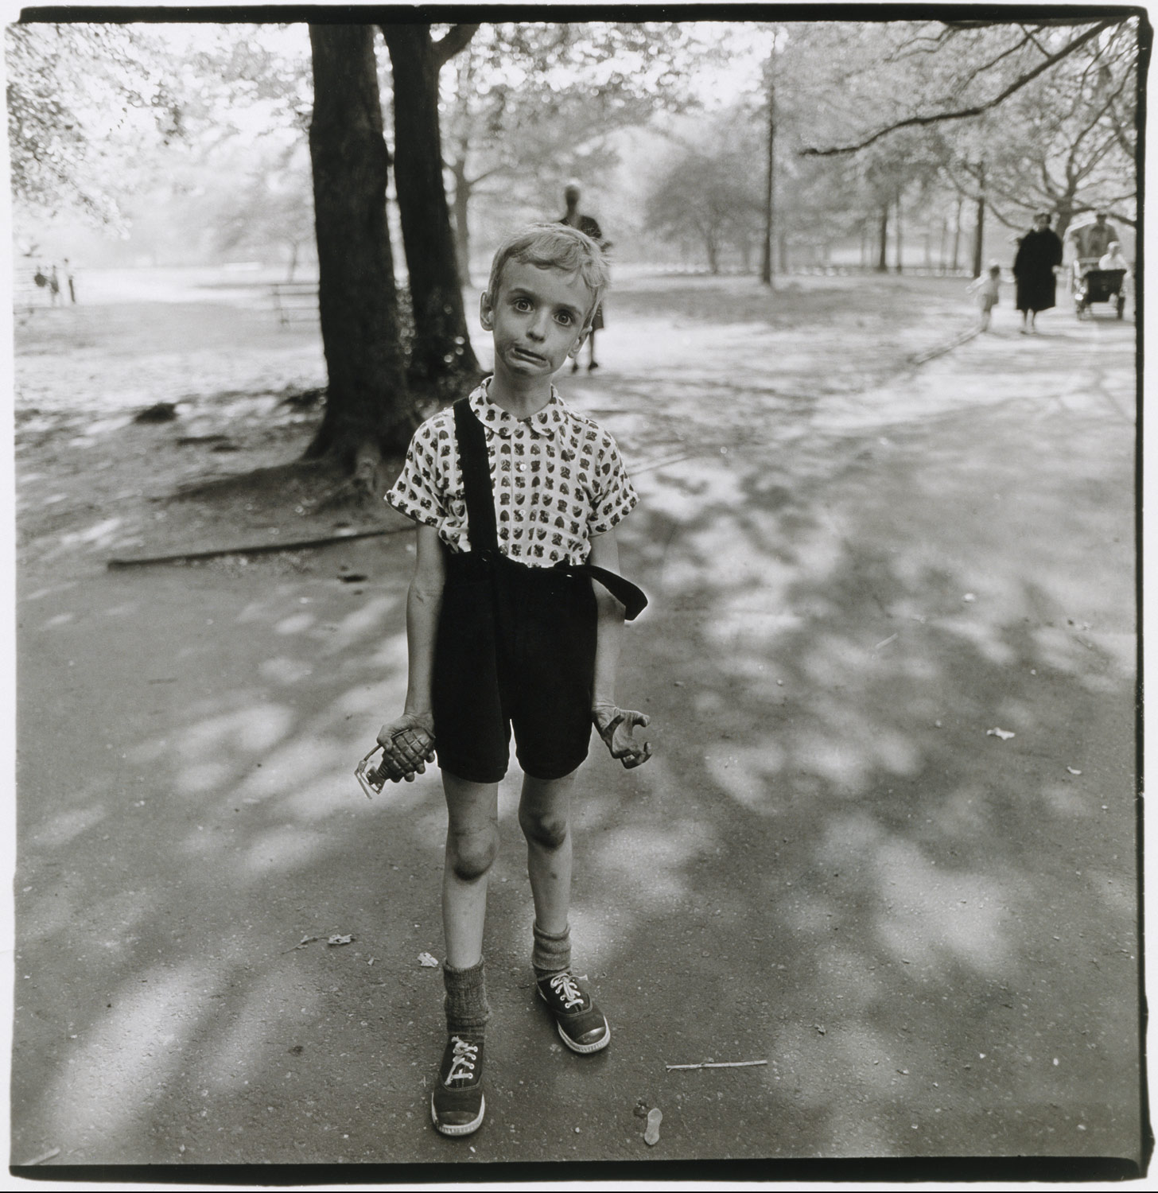
Are they still relevant today?
‘To an ever greater degree the work of art reproduced becomes the work of art designed for reproducibility. From a photographic negative, for example, one can make any number of prints; to ask for the “authentic” print makes no sense. But the instant the criterion of authenticity ceases to be applicable to artistic production, the total function of art is reversed’
(Benjamin 1936)
Notes:
Yet the technologies he himself deployed in developing his reflections had existed for hundreds of years

Slide 20
So are ‘the humanities’ in crisis today?
‘The humanities in modern times … have developed a close alliance with writing and print. Writing and print are here to stay and will certainly amount to even more in the future than in the past, but … they are now interwoven with newer media—radio, television, the cinema, and other devices—with which they interact and which transform them …’
Notes:
Talk to a neighbour:
can new media change what we study, when we try to understand ‘what it means to be human’?
can new media changed how we study ‘what it means to be human’?

Slide 21
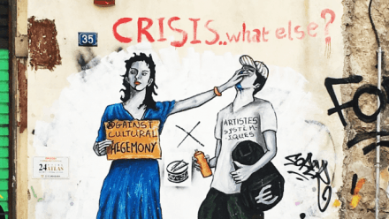
Or are they always in crisis?
‘The humanities are certainly in an unsatisfactory state, but are also probably better off than at any time before in history. For, if they are alive, the humanities are always in a state of crisis. Man’s [sic] life is one of crises, and the humanities do not stand outside man's life but live within it. The unchallenged life is not worth living’
(Ong 1971: 21-2)
Notes:
Does the use of ICT, by contrast, offer new ways of making sense of the world?
SM: what now becomes available as evidence, what analytic techniques can be applied to both old and new kinds of evidence, what kinds of narratives can be created?

Slide 22
Further reading
F. Bacon (1605) The advancement of learning. Retrieved from http://www.philosophy-index.com/bacon/advancement-learning/ii-v.php
W. Benjamin (1936) ‘The work of art in the age of mechanical reproduction’. Retrieved from https://www.marxists.org/reference/subject/philosophy/works/ge/benjamin.htm
M. Bloch (1984) The historian’s craft. Manchester: Manchester University Press.
D. Bodenhamer, J. Corrigan & T. Harris (2010) The spatial humanities: GIS and the future of humanities scholarship. Bloomington: Indiana University Press.
S. Bologna (2004) ‘The social reality of knowledge workers’. Paper presented to the Humanities Conference, Prato, 20-22 July. Retrieved from www.lumhi.net%2FTESTI%2520collegati%2FS_Bologna%2FPratofulltext.doc
S. Collini (2015) ‘Seeing a specialist: The humanities as academic discipline’, Past and Present 229.
P. Drucker (2012) Managing in a time of great change. London: Routledge.
Federation University Australia (2017) ‘Faculty of Education and the Arts’. Retrieved from https://federation.edu.au/faculties-and-schools/faculty-of-education-and-arts/areas-of-study/humanities-and-social-sciences
J. Giedymin (1975) ‘Antipositivism in Contemporary Philosophy of Social Science and Humanities’, The British Journal for the Philosophy of Science, 26/4.
C. Ginzburg (1990) ‘Morelli, Freud and Sherlock Holmes: Clues and scientific method’, History Workshop Journal 9, Spring.
I. McNeely & L. Wolverton (2008) Reinventing knowledge: from Alexandria to the Internet. New York: Norton.
W. Ong (1971) Rhetoric, romance and technology. Ithaca: Cornell University Press.
A. Smith (2007) An inquiry into the nature and causes of the wealth of nations. Amsterdam: ΜεταLibri.

